Slide 1
Parrot In The Oven
By: Victor Martinez
By: Alyvia Ferrier
Mr. Heoring
Period 1

Slide 2
Summary
The book Parrot In The Oven is about a boy named Manny Hernandez and his parents are abusive. His dad abuses him and goes out and gets drunk every night. His mom cleans the house like she is going to wash her troubles away, and his brother can’t keep a job. Manny wants to fit in with everybody so he joins a gang and realizes that he doesn’t have to be in a gang to figure out who ho really is.

Slide 3
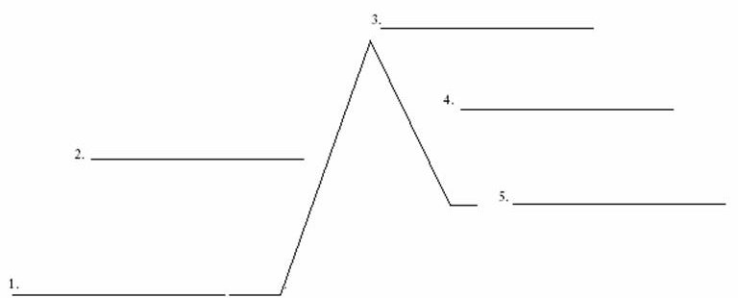
Plot Diagram
Manny almost shoots Pedi
Manny joins a gang
Dad tries to shoot the Mom
Manny realizes that he doesn’t have to be in a gang to realize who he is.
Nardo can’t get a job.

Slide 4
Setting and Tone
This book takes place in California in the 1900’s. Manny was usually at home or at school in the book. The author’s tone in the book states that Manny doesn't like being at home with his family.

Slide 5
Main Character, Traits, and Influences
Manny is… Manny’s Traits are… Manny's Influences...
Alone Brown hair Gang Influences
Hurt Scared Mom Influences
Brave Follower Brother Influences
Confident Dad Influences

Slide 6
Conflict
The main conflict in the book Parrot in the Oven is, Manny trying to get through life while getting abused by his parents. As said on pages 26 and 27 it states, "When they started shouting and throwing their arms around, which I knew they'd do once mom walked in through the door, it was best to disappear. Even the walls sweated. Mom's shrieks chased away the panicked air; Dad's voice was coarse paper shredding to pieces." That suggests that his parents aren't safe to be around.

Slide 7
Theme #1
One theme that I learned from the book Parrot in the Oven is you shouldn’t do drugs because your future could turn out bad for you and your family. As said in the book Parrot in the Oven, “Dad had just lost his job as a translator for the city because he’d drink beer during lunch and slur his words.”

Slide 8
Theme #2
Another theme that I found in the book Parrot in the Oven is hard work pays off. As said on page 215, “It was wondrous, like a place I was meant to be. A place, I felt, that I had come back to after a long journey of being away. My home.”

Slide 9
Theme #3
The last theme that I got from the book Parrot in the Oven is abuse is never the answer. As said on page 35, “I pushed the curtains back and saw him wrestling with the arm of the gear shift, which sometimes stuck. He slammed his feet on the floor and shook the wheel; then, relaxing his hands, he stared hard at me, like I was weeds growing wild in a field that someday he'd have to chop."

Slide 10
Novel Comparison
The last book I read was called Self Destructed. This book is different from the book Parrot In The Oven because Self Destructed was a little more interesting than Parrot In The Oven. These books are similar because the main character in Self Destructed went to jail because he brought a gun into school, and the dad in Parrot In The Oven went to jail because he tried to shoot his wife.

Slide 11
Most Impactful Signpost
The most impactful signpost that I had was a contrast and contradiction. My contrast and contradiction was the dad trying to shoot the mom with really no reason. The dad did this because he came home to a messy house and got mad and found out that the mom went to go het her hair done. He then walked over to the hair shop and tried to shoot his wife. This was a little out of character for the dad to just try and shoot his wife.

Slide 12
Conclusion
The most memorable aspect in the book Parrot In The Oven for me personally is when the dad tried to shoot the mom. This event is memorable to me because this was one of the more serious events. I also liked it because it had a lot of action. I think the book Parrot In The Oven is important because it shows that if you have gotten abused or you are or were the abuser, that it could ruin your life. I recommend this book to anyone who likes books that have action and books that keep you on the edge of your seat. I liked this book and I think that you will too.

